Slide 1
CSCI3170 Introduction to Database Systems
Tutorial 7 – NORMAL FORMS
Vito, CHEN Jiamin
2021/2022 T1

Slide 2
Outline
Decomposition problems and goals
1st , 2nd, 3rd and Boyce Codd normal form (BCNF)
Decomposition algorithms

Slide 3


Last week
(cont.) Problems caused by redundancy:
Decomposition
Functional dependency
- How do we find redundance?
- How to make use of FDs for
decomposition?
- What are the goals of decomposition
(schema design)?
Id | name | age | rating | Hourly_wages | Hours_worked
123-22-3666 | Peter | 48 | 8 | 10 | 40
231-31-5368 | Paul | 22 | 8 | 10 | 30
131-24-3650 | Mary | 35 | 5 | 7 | 30
434-26-3751 | David | 35 | 5 | 7 | 32
612-67-4134 | Ada | 35 | 8 | 10 | 40
$$rating→Hourly_wages$$
$$Id→name?$$

Slide 4
Decomposition
{R₁, …, R_{n}} – a set of relation schemas
Def: {R₁, …, R_{n}} is a decomposition of R
if R₁ ⋃ R₂ ⋃ … ⋃ R_{n} = R
e.g.
R = (A, B, C)
R₁ = (A, B)
R₂ = (A, C)
R₁ and R₂ is a decomposition of R
Id | name | age | rating | Hours_worked
123-22-3666 | Peter | 48 | 8 | 40
231-31-5368 | Paul | 22 | 8 | 30
131-24-3650 | Mary | 35 | 5 | 30
434-26-3751 | David | 35 | 5 | 32
612-67-4134 | Ada | 35 | 8 | 40
rating | Hourly_wages
8 | 10
5 | 7

Slide 5
Decomposition
Problems caused by decomposition:
Expensive queries (unavoidable)
Information loss
Dependencies break into relations
Id | name | age | rating | Hours_worked
123-22-3666 | Peter | 48 | 8 | 40
231-31-5368 | Paul | 22 | 8 | 30
131-24-3650 | Mary | 35 | 5 | 30
434-26-3751 | David | 35 | 5 | 32
612-67-4134 | Ada | 35 | 8 | 40
rating | Hourly_wages
8 | 10
5 | 7

Slide 6
Decomposition
Problems caused by decomposition:
Expensive queries (unavoidable)
Information loss
Dependencies break into relations
Id | name | age | rating | Hours_worked
123-22-3666 | Peter | 48 | 8 | 40
231-31-5368 | Paul | 22 | 8 | 30
131-24-3650 | Mary | 35 | 5 | 30
434-26-3751 | David | 35 | 5 | 32
612-67-4134 | Ada | 35 | 8 | 40
rating | Hourly_wages
8 | 10
5 | 7

Slide 7
Lossless Join Decomposition
The relation schemas { R₁, R₂, …, R_{n} } is a lossless-join decomposition of R if:
for all possible relation instances r on schema R,
r = Π _{R1}( r ) ⋈ Π _{R2}( r ) ⋈ … ⋈ Π _{Rn}( r )
e.g.
Is this decomposition lossless?
IN
sid
major
Student
sid
sname
major
IM
sname
major
NO! (instance example in ch19)

Slide 8
Example: a non-lossless join decomposition
IN
sid
major
Student
sid
sname
major
IM
sname
major
Student
IN
Student = IN ⋈ IM????
IM

Slide 9
IN
IM
IN IM
Student
The instance of ‘Student’ cannot be recovered by joining the instances of IN and IM. Therefore, such a decomposition is not a lossless join decomposition.

Slide 10
Example: a lossless join decomposition
IN
sid
sname
Student
sid
sname
major
IM
sid
major
Student
IN
‘Student’ can be recovered by joining the instances of IN and IM
IM

Slide 11
Dependency Preservation
R - a relation schema F - set of functional dependencies on R
{ R1, R2 } - a decomposition of R.
Fi - the set of dependencies in F+ involves only attributes in Ri.
Dependency is preserved if
( F₁ U F₂ )⁺ = F ⁺
e.g.
Dependency set: F = { sid → sname, sid → major }
Yes!
IN
sid
major
Student
sid
sname
major
IM
sid
sname

Slide 12
Normal Forms
To understand what problems arise from the current schema.
Several normal forms have been proposed.
If a relation schema is in one of these normal forms, we know that certain kinds of problems cannot arise.

Slide 13
Normal Forms
1st Normal Form | No repeating data groups
2nd Normal Form | No partial key dependency
3rd Normal Form | No transitive dependency
Boyce-Codd Normal Form | Reduce keys dependency
4th Normal Form | No multi-valued dependency
5th Normal Form | No join dependency

Slide 14
1st & 2nd Normal Forms
1NF: A relation is in 1st normal form if every attribute in that relation is singled valued attribute.
2NF: A relation is in 2nd normal form if
it has No Partial Dependency, and
it is in 1st normal form.
Partial Dependency – If the proper subset of candidate key determines non-prime attribute, it is called partial dependency.

Slide 15
Violates 2nd normal form
2NF - Example
Candidate key: (TeacherID, Subject) and TeacherID → Age
TeacherID | Subject | Age
12 | Chemistry | 37
12 | Biology | 37
18 | English | 31
7 | Math | 30
7 | Computer | 30

Slide 16
3rd Normal Form (3NF)
R – a relation schema
F – a set of functional dependencies on R
A – a single attribute in R
3NF: R is in 3NF if ALL α → A in F
α → A is trivial (A ∊ α), OR
α is a superkey for R, OR
A is part of some key for R
E.g. , If AB is a key for R then A is a part of the key, B is also a part of the key.

Slide 17
3NF – Example
R = (A, B, C, D, E)
F = {AE → BCD, D → A}
Key = {AE, DE}
R is in 3NF:
Consider AE → BCD in F
AE is a superkey!
Consider D → A in F
A is a part of the key AE!
R is in 3NF if ALL α → A in F
α → A is trivial (A ∊ α), OR
α is a superkey for R, OR
A is part of some key for R

Slide 18
Boyce Codd normal form (BCNF)
R – a relation schema
F – a set of functional dependencies on R
R is in BCNF if ALL α → A in F
α → A is trivial (A ∊ α), OR
α is a superkey for R
OR(3NF) A is part of some key for R
Note:
√ | If R is in BCNF then
 | R is in 3NF
× | If R is in 3NF then
 | R is in BCNF

Slide 19
BCNF – Example1
R = (A, B, C, D, E)
F = {AE → BCD, D → A}
Key = {AE, DE}
R(in 3NF) is in not BCNF:
Consider D → A
{ A } ⊄ { D }, it’s not a trivial FD
D is not a key for R.
R is in BCNF if ALL α → A in F
α → A is trivial (A ∊ α), OR
α is a superkey for R
BCNF implies 3NF but 3NF cannot imply BCNF!!!

Slide 20
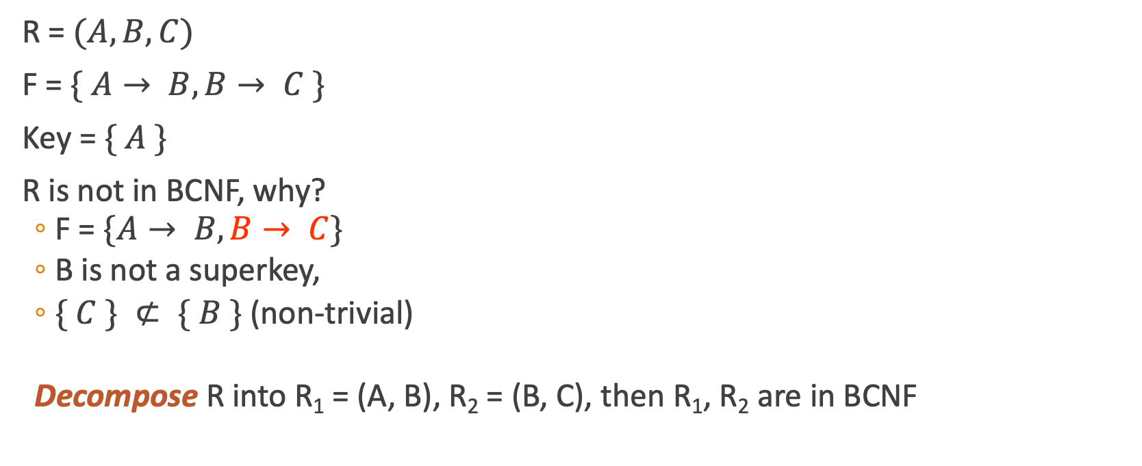
BCNF – Example2
R = $(A, B, C)$
F = $\{ A→ B, B→ C \}$
Key = $\{ A \}$
R is not in BCNF, why?
F = $\{A→ B, B→ C\}$
B is not a superkey,
$\{ C \} ⊄ \{ B \}$(non-trivial)
Decompose R into R₁ = (A, B), R₂ = (B, C), then R₁, R₂ are in BCNF
R is in BCNF if ALL α → A in F
α → A is trivial (A ∊ α), OR
α is a superkey for R

Slide 21
BCNF Decomposition Algorithm
Suppose R is not in BCNF, A is an attribute, and X → A is a FD that violates the BCNF conditions.
Remove A from R
Decompose R into XA and R-A
Repeat this process until all the relations become BCNF

Slide 22
BCNF Algo - Example
R = (A,B,C,D,E)
Key = AC
F = {A → B,A → D,C → E}
Please perform BCNF decomposition on R

Slide 23
BCNF Algo - Example
R = (A,B,C,D,E)
Key = AC
A → B

Slide 24
BCNF Algo - Example
R = (A,B,C,D,E)
Key = AC
A → B
A → D

Slide 25
BCNF Algo - Example
R = (A,B,C,D,E)
Key = AC
A → B
A → D
C → E

Slide 26
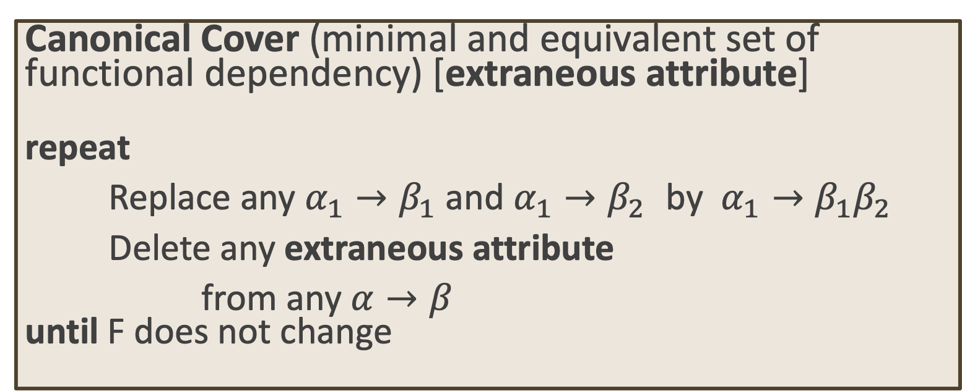
3NF Decomposition Algorithm
Canonical Cover (minimal and equivalent set of functional dependency) [extraneous attribute] repeat
Replace any $α_{1}→β_{1}$ and $α_{1}→β_{2}$ by $α_{1}→β_{1}β_{2}$
Delete any extraneous attribute
from any $α→β$ until F does not change

Slide 27
Normalization
Consider algorithms for converting relations to BCNF or 3NF.
If a relation schema is NOT in BCNF:
it is possible to obtain a lossless-join decomposition into a collection of BCNF relation schemas.
Dependency-preserving is not guaranteed.
3NF:
There is always a dependency-preserving, lossless-join decomposition into a collection of 3NF relation schemas.

Slide 28
Remarks
Functional Dependency & Normal Forms
Normalization(Decomposition)
Design goals:
BCNF (or 3NF acceptable)
Lossless join
Dependency preservation

